Slide 1
Virtual Teams
Face to Face is Dead:
Running effective meetings without borders
Notes:
Joe slides 1-5
Kathy slides 6-10
Joe slides 11-13

Slide 2
Why are we here?
Is your workday spent in virtual meetings?
So many teams are virtual that the era of face to face meetings seems like a distant memory.
Virtual teams can include people from across the globe or people working in the same state but in different buildings.
Virtual teams have special challenges such as building trust and camaraderie that effect team effectiveness.
Let’s learn some tricks on being more effective when working with virtual teams.

Slide 3
Virtual Team Definition
“A virtual team (also known as a geographically dispersed team or GDT) is a group of individuals who work across time, space and organizational boundaries with links strengthened by webs of communication technology. “
Source: http://en.wikipedia.org/wiki/Virtual_team
Examples:
Working teams across regions
Teams with individuals in different buildings in PA
    Potentially even the same building

Slide 4
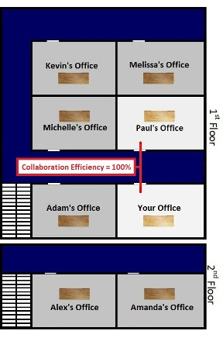
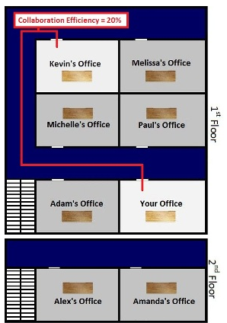
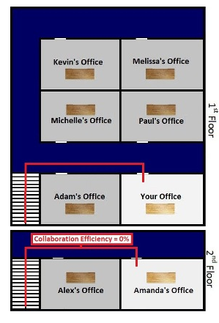
Bell Lab Study
Team members in the same corridor are 5X more likely to collaborate than team members on the same floor in separate corridors
Team members on separate floors are even less likely to collaborate
Source of pictures: http://portal.zzeem.com/virtualteambuilders/tabid/1145/Default.aspx

Slide 5
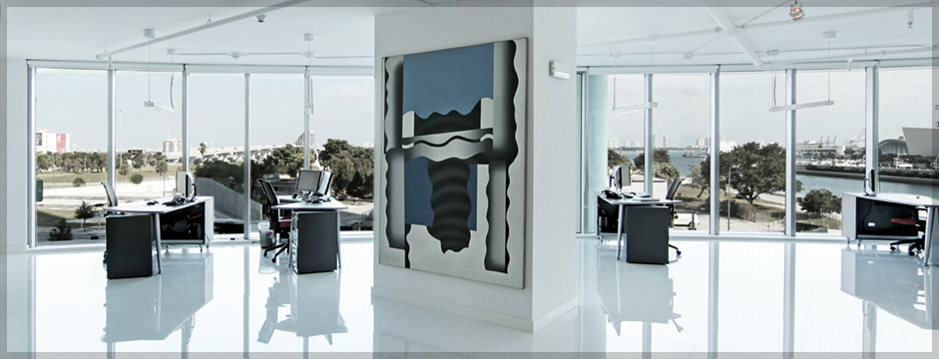
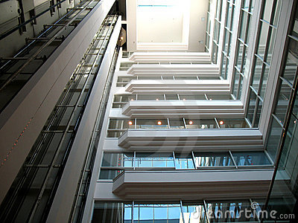
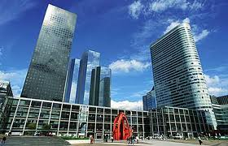
Communications and Distance
Next Door
Likely to communicate weekly
Same Aisle
Rare to communicate weekly
Different floor or across the globe
Slim chance of communicating weekly

Slide 6

Key Challenge
Establishing trust in virtual teams is the key challenge to team success
  Trust is crucial for team success since it drive team cohesiveness
    Trust is problematic for virtual teams since it is difficult for people to trust each other if they have never or rarely met face–to-face.
    Building trust takes time. Yet, often Virtual teams are often short lived and change often.
    The lack of face-to-face time also results in weaker social links between team members which leads the team to be more task-focused and less socially focused. Yet, teams that communicate more socially achieve higher trust and better relationships.
  Lack of face to face communicate can damage trust
    Non-verbal cues, e.g. body language, tone of voice, represent almost two thirds of the way we understand what is being said and help to build trust.
    The use of sarcasm and jokes in non f2f channels can be misinterpreted.
    “Virtual silence“, when an email or a text is sent but no immediate response is received, can be interpreted as a negative response.
  Cultural differences, common in virtual teams, adds another dimension to building trust
    There are two main types of human cultures, high and low context.
    High context cultures (Asia, South America and the Middle East) do not express their feelings and thoughts explicitly and can perceive low context cultures are too talkative and obvious.
    Low context cultures (North American and Europe) are much more open and direct and can perceive high context cultures are sneaky and mysterious.
  A study by Cisco Systems on virtual teams quantifies this phenomenon:
    Virtual teams can take up to four times longer to build trust than co-located teams
    Virtual teams with different cultures can take up to 17 weeks to bond and perform as well as a co-located team.
Sources:
http://en.wikipedia.org/wiki/Virtual_team
http://www.guardian.co.uk/technology/2006/sep/28/guardianweeklytechnologysection.insideit2

Slide 7

Building Trust
Foster relationship building and teaming
    Listen to team members
    Understand preferences and adapt
    Provide continuous feedback
Focus on communication
    Use a mix of communication: f2f, WebEx, video conferencing, emails, voicemail, emails with voice message, …
    Be all virtual or all in person whenever possible
    Include team members pictures in a virtual meeting
    Use paraphrasing and summarize
    Communicate one on one, in small sub-teams and with the whole team
    If your tone of voice may be difference due to some issue, announce that to the team
Define a team vision – Create a Team Operating Agreement
Build Camaraderie
Use Technology as an enabler

Slide 8

Team Operation Agreement (TOA)
An agreement put in place around how the team should operate
    Ex: Meeting schedule, time of meetings, participation requirements
The whole team should agree upon this document
    If a team member changes it should be re-visited
  Example topics for the TOA:
    Meetings Cadence & Rules
    Communications
    Decision-Making
    Conflicts
    Team Member Roles

Slide 9


Building Camaraderie
  Meet face to face at least once
  Try to infuse the social aspect into the team
    Have team members send you something unique about them and then share at team meetings and have people guess who that is
    Acknowledge personal milestones (like tenure, new family members, etc.)
    Share a personal photo and have the team members share the story around it (like a special vacation, family event, etc.)
  Communicate and celebrate team successes
    Monthly newsletter with successes and accomplishments
    Send thank you cards
    Pick up the phone and say thank you
    Give e-gift certificates
    Give paper certificate recognizing team members contributions
    Circle of Thanks - Ask each person on the call to thank another team member
    Arrange for the group to present results to an executive

Slide 10

Using Technology
Get proficient at the technology your company uses
Use the Whiteboards for team brain storming
Try video conferencing to see team members
Use hand raising to facilitate virtual meetings
Leverage polls to engage all team members
Make it visual – Share pictures!
To mute or not to mute, that is the question. Agree as a team!

Slide 11
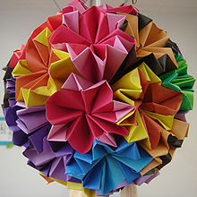
Exercise
Pair up with someone you don’t know
Partners each grab a plain piece of paper and go to a part of the room and stand back to back
Introduce yourself to each other
One partner will give verbal directions on how to fold the paper
Both partners will fold their paper based on the verbal directions
Now turn around and compare your folded papers. Are they the same or different? Why?

Slide 12
Key Take-Away
You are a virtual team even if you are not working with Global partners. Take this into Account!
Find ways to keep your audience on the phone engaged, not just in the room.
Use collaboration tools and techniques to work with team members no matter the location

Slide 13
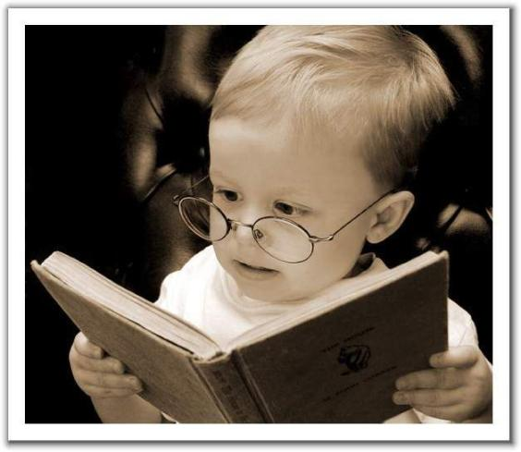
Resources
  Book - Building a High-Performance Team by Sara Cook
  Whitepaper - How to manage Virtual Teams By Frank Siebdrat, Martin Hoegl and Holger Ernst
    http://sloanreview.mit.edu/the-magazine/2009-summer/50412/how-to-manage-virtual-teams/
  Adrianna Beal’s website
    http://adrianabeal.com/index.php/Main/Presentations

